Slide 1
The World of Agile Software Development
(or, “Creating a fair playing field in 30 minutes”)
Alistair Cockburn
alistair.cockburn@acm.org
http://members.aol.com/acockburn
www.CrystalMethodologies.org

Slide 2
What agile is and what it isn’t
Context: What is ‘methodology’
Reality check: The methodology-ecosystem interplay
History: How did “agile” arise
Reality check: Methodology attitudes are “would-be”
Is / Isn’t: Misconstruing the message

Slide 3
Components of a methodology
Activities
Milestones
Planning
Testing
Team Values
Quality
Processes
Teams
Regression tests
Project manager
MBWA
Documenter
Object model
Use cases
Project plan
Designer
CRC cards
Tester
Use cases
Products
Techniques
Roles
Microsoft Project
Envy/Developer
JAD facilitation
3month increments
STP
Java programming
UML / OMT
Microsoft Project
Modeling
Personality
C++
Standards
Tools
Skills

Slide 4
Scope of a methodology
rest and recreation
Activities
vacations and basic business
technical education
timesheets
project development
project sponsor
project manager
expert user
business expert
lead designer
UI expert
Roles
reuse point
designer/programmer
tester
writer
trainer
secretary
contractor
night watchman
Project Lifecycle
janitor
envisioning
proposal
sales
setup
requirements
design & code
test
deploy
train
alter

Slide 5
Aspects of a methodology
Factory
Products
Control
System
Notation
Tools
People, Organization, Culture

Slide 6
Reality check 1: methodology-ecosystem interplay
What is the “Ecosystem” of a project
Actual project details (“environment”)
Actual staff expertise (“species”)
Flights of stairs people must climb (“cliffs”)
Specific dominant / mild people (“predators”)
Office layout (“terrain”)
etc.
When each changes, the ecosystem rearranges itself.

Slide 7
People are stuffed full of personality.
The methodology changes to fit the people.
Activities
Milestones
Team Values
Quality
Process
Teams
Regression tests
Project manager
Jim
MBWA
Documenter
Object model
Use cases
Peter
Project plan
Designer
Jenny
CRC cards
Tester
Annika
Use cases
Products
Techniques
Roles
People
Microsoft Project
Envy/Developer
JAD facilitation
3month increments
STP
Java programming
UML / OMT
Microsoft Project
Modeling
C++
Personality
Standards
Tools
Skills

Slide 8
Example of methodology restructuring:
Rearrange job sets around personality groupings
Marketing
group
Business
analysts
Jenny
(Pete)
Programmers
Marketplace
Bill
Mary

Slide 9
Different projects need different methodologies
(Each project is a separate game)
. . .
Prioritized for Legal Liability
Prioritized for Productivity & Tolerance
Life
(L)
Criticality
(defects cause loss of...)
L6
L20
L40
L100
L200
L500
L1000
Essential
money
(E)
E6
E20
E40
E100
E200
E500
E1000
Discretionary
money
(D)
D6
D20
D40
D100
D200
D500
D1000
Comfort
(C)
C6
C20
C40
C100
C200
C500
C1000
1 - 6
- 20
- 40
- 100
- 200
- 500
- 1,000
Number of people involved
+20%

Slide 10
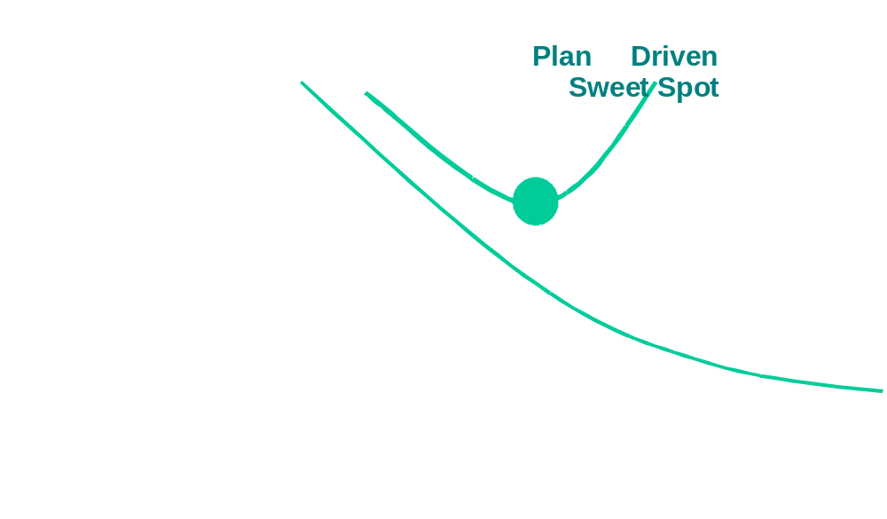
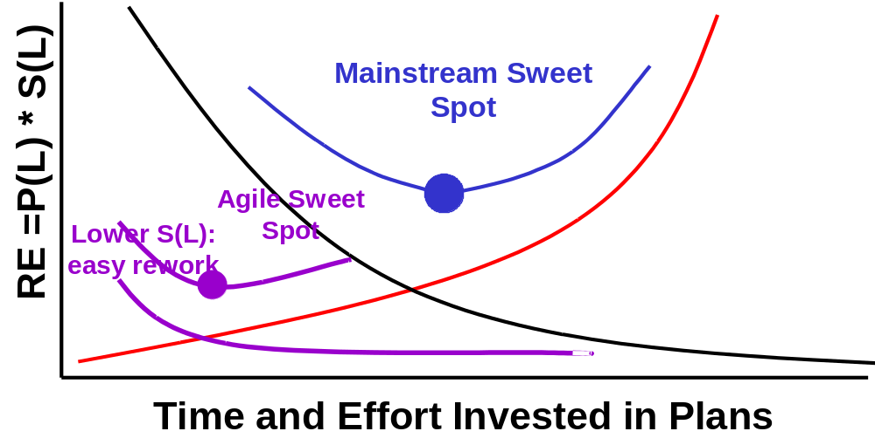
The “correct” mix of planning vs. reacting depends on the individual project’s risk exposure.
from “Get Ready for Agile Methods – With Care”
(Barry Boehm, IEEE Computer, January 2001)

Slide 11
History: How did “agile” arise
“Agile” techniques were in use since the beginning.
Agile (mobility-based) techniques did not show competitive advantage in the 1970s / 1980s,
but did during the 1990s and do now.
1994: trials of semi-formal agile methodologies
RAD DSDM
XP Crystal
Scrum Adaptive

Slide 12

Agile Software Development Manifesto
- a declaration of values
“We are uncovering better ways of developing software by doing it and helping others do it.
Through this work we have come to value:
  Individuals and interactions over Processes and Tools.
  Working software over Comprehensive documentation.
  Customer collaboration over Contract negotiation.
  Responding to change over Following a plan.
That is, while there is value in the items on the right, we value the items on the left more.”
(Kent Beck, Mike Beedle, Arie van Bennekum, Alistair Cockburn,
Ward Cunningham, Martin Fowler, James Grenning, Jim Highsmith,
Andrew Hunt, Ron Jeffries, Jon Kern, Brian Marick, Robert Martin,
Stephen J. Mellor, Ken Schwaber, Jeff Sutherland, Dave Thomas )

Slide 13
Reality check: Methodologies are only attitudes, a centering of the attention.
Declarations of core values declare an “attitude”
An attitude can not promise success in the future,
it can only be spoken successfully in the past tense.
it is only a wish to be...
A would-be agile process
A would-be predictable process
A would-be repeatable process
A would-be inexpensive process

Slide 14
The Agile attitude focuses on:
1. Talent & Skill (fewer better people)
2. Proximity (developers - developers - users)
3. Communication (morale, daily standup)
4. Just-in-time requirements and design
5. Frequent Delivery (incremental development)
6. Reflection
7. Less paper, more tacit / verbal communication
8. Tools
9. Quality in work
10. Different strategies for different projects

Slide 15
Is / Isn’t: Misconstruing the message
1. Agile SD is cheating
2. Agile SD requires the best developers
3. Agile SD is hacking
4. Agile SD won’t work for all projects

Slide 16
1. Agile techniques are “cheating”.
· Hire good people;
· Seat them close together to help each other out;
· Get them close to the customers and users;
· Arrange for rapid feedback on decisions;
· Let them find fast ways to document their work;
· Cut out the bureaucracy.
This is:
cheating
stacking the deck
a good idea
the heart of agile software development

Slide 17
2. Agile only works with the best developers.
Every project needs at least one experienced and competent lead person. (Critical Success Factor)
Each experienced and competent person on the team permits the presence of 4-5 “average” or learning people.
With that skill mix, agile techniques have been shown to work many times.

Slide 18
Faulty logic in action:“Agile processes require a few Competent and Experienced (C&E) people.”
Proposition (T): To use agile, I need a few C&E people.
Inverse (F): If I am not using an Agile process,
I don’t need any C&E people on my project ..?
Logical Flaw: If I don’t have any C&E people, I can (... “suffer” ...)
Conclusion: With a few C&E people, I can use almost any process ... without them, no process will work.)
Contrapositive (T): Without a few C&E people,
I can’t use agile processes.

Slide 19
3. Agile is hacking.
(Hacker interpretations are available & inevitable.)
Hackers: “...spend all their time coding”
Agilists: ...test according to project priorities,
recheck results with users often.
Hackers: “...talk to each other when they are stuck”
Agilists: ...talk to each other and customers as
a matter of practice.
Hackers: “...avoid planning”
Agilists: ...plan regularly
Hackers: “...management caves in out of fear”
Agilists: ...expect management to provide priorities,
& participate jointly project adjustments.

Slide 20
4. Agile won’t work for all projects.
Right. (Business isn’t fair).
Agile is an attitude prioritizing:
Project evaluation based on delivered code
Rapid feedback
People as a value center
Creativity in overcoming obstacles
Not every team
... values the Agile value set.
... can set up the needed trust and communication

